Slide 1
Awesome Hotels
Anirudh Bagri

Slide 2
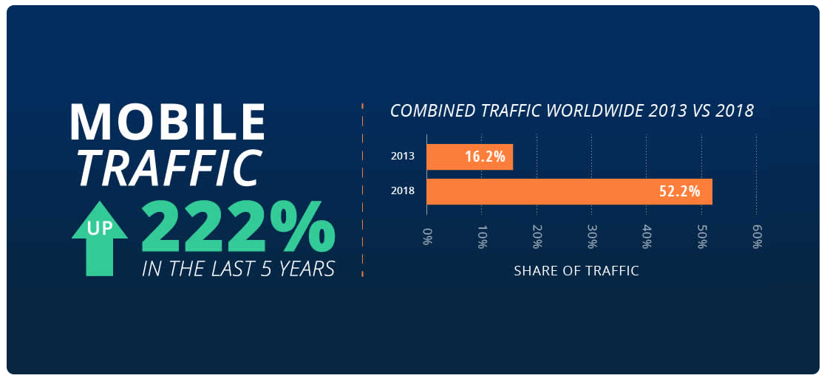
Why Mobile?

Slide 3


Tech – Stack
Backend – Flask (python)
Frontend – Flutter (Dart)

Slide 4
Some Considerations
Getting list of hotels is available to all
Posting your entry requires login.

Slide 5
Features
List all hotels – is it a feature? Or was it a requirement?
Search hotel by name
Sort hotel by price
Check if it’s a private/shared room
Get rating of a hotel
Get preview of location
Open maps to navigate

Slide 6


Bonus
DARK MODE ;)
Made using flutter, available in both:

Slide 7
A Big
Thank You!

